Slide 1
US Economy and Coronavirus Economics
Central Coast Chapter of the CSMFO,
Doris Geide-Stevenson, Ph.D. Weber State University, Ogden, UT

Slide 2
National Economic Education Delegation
Vision
One day, the public discussion of policy issues will be grounded in an accurate perception of the underlying economic principles and data.
Mission
NEED unites the skills and knowledge of a vast network of professional economists to promote understanding of the economics of policy issues in the United States.
NEED Presentations
Are nonpartisan and intended to reflect the consensus of the economics profession.

Slide 3
Who Are We?
Honorary Board: 54 members
2 Fed Chairs: Janet Yellen, Ben Bernanke
6 Chairs Council of Economic Advisers
Furman (D), Rosen (R), Bernanke (R), Yellen (D), Tyson (D), Goolsbee (D)
3 Nobel Prize Winners
Akerlof, Smith, Maskin
Delegates: 640+ members
At all levels of academia and some in government service
All have a Ph.D. in economics
Crowdsource slide decks
Give presentations
Global Partners: 48 Ph.D. Economists
Aid in slide deck development

Slide 4
Credits and Disclaimer
This slide deck was authored by:
Jon D. Haveman, NEED
Scott Baier, Clemson University
Geoffrey Woglom, Amherst College (Emeritus)
Brian Dombeck, Lewis & Clark College
Doris Geide-Stevenson, Weber State
Disclaimer
NEED presentations are designed to be nonpartisan.
It is, however, inevitable that the presenter will be asked for and will provide their own views.
Such views are those of the presenter and not necessarily those of the National Economic Education Delegation (NEED).

Slide 5
Outline
State of the pandemic
The U.S. Economy
Total Output
Policy Support
Labor Market
Inflation
Great Resignation
Equity Markets

Slide 6
State of the Pandemic

Slide 7
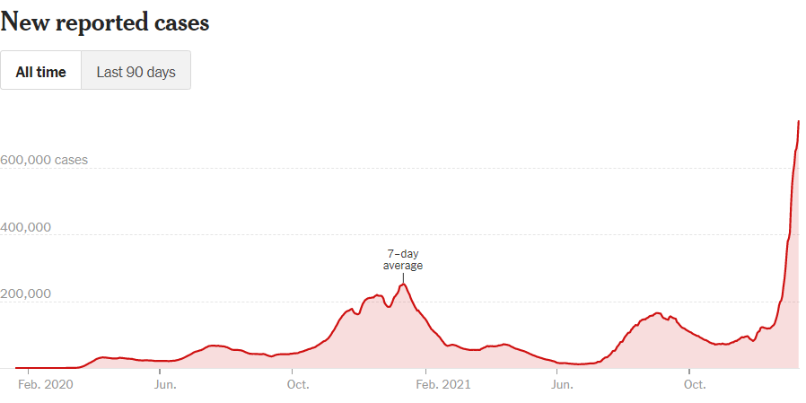
Making Real Progress…Until Omicron
Source: NYTimes

Slide 8
California Cases Were Falling Nicely
Source: NYTimes, Jan. 11, 2022

Slide 9
California – Hospitalizations and Deaths
Source: New York Times, Jan. 11, 2022

Slide 10
The U.S. Economy
The Role of the Pandemic versus Policy Adjustments?

Slide 11
GDP Trajectory: Pandemic Plunge and Recovery
GDP is:
$0.5 Trillion below 2019 forecast.
$0.2 Trillion ABOVE 2019-Q4 level.
Notes:
Above pre-pandemic levels, but not back to potential output.

Slide 12
Spending Patterns Since First US Case
Q3 - Flat
Source: https://tracktherecovery.org/
Notes:
San Luis Obispo +18.4% , Santa Barbara +25.7%

Slide 13
But Not All Industries Were Equally Harmed

Slide 14
Unprecedented Policy Support
Source: Vanguard Economic and Market Outlook for 2022:Striking a better balance

Slide 15
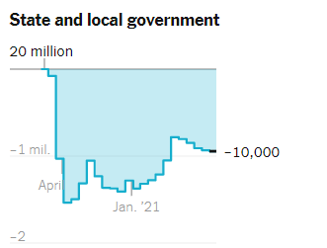
Employment Changes - US
Source: New York Times

Slide 16
Employment Gap
3.9 Million below February, 2020.
8.6 Million below where we should be.
Notes:
payroll_recent.png

Slide 17
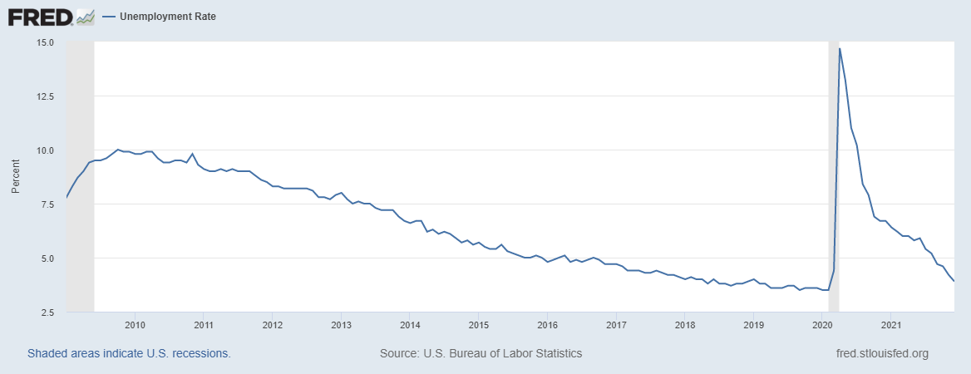
Labor Force Participation and Unemployment

Slide 18
Labor Force Growth in San Luis Obispo Co.
Notes:
US Nov. 2021 3.9% California 6.9% San Luis Obispo 3.6%

Slide 19
Inflation News – Today
Source: Wall Street Journal

Slide 20
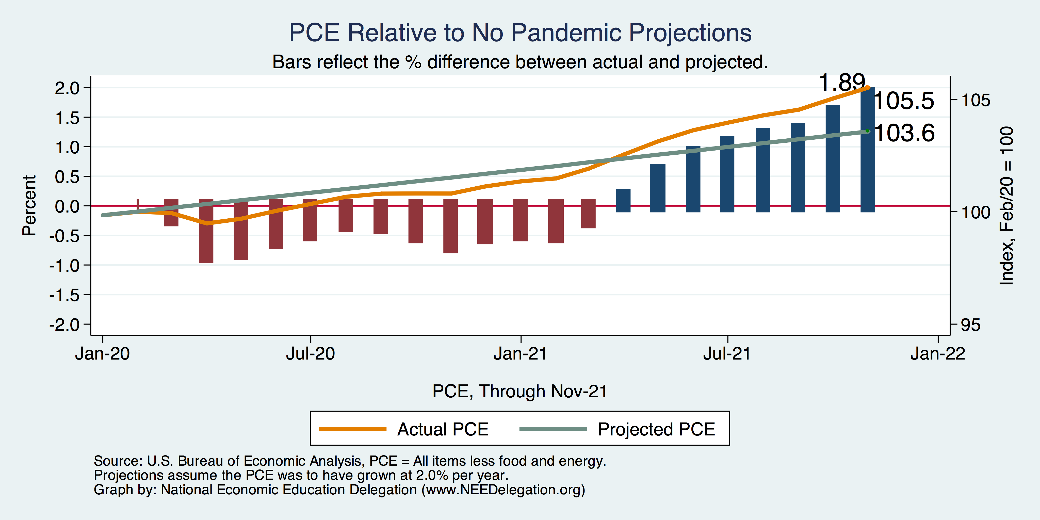
Inflation – PCE and Fed Suggest: I don’t know.
Notes:
Cpi_recent.png

Slide 21
Measure of Inflation Expectations
Breakeven Inflation Rate = Difference between
nominal and real 10-year Treasury constant
Maturity securities.
Market participants still expect around 2.5%
of inflation annually over the next 10 years.
Inflation expectations are still ‘anchored’.

Slide 22
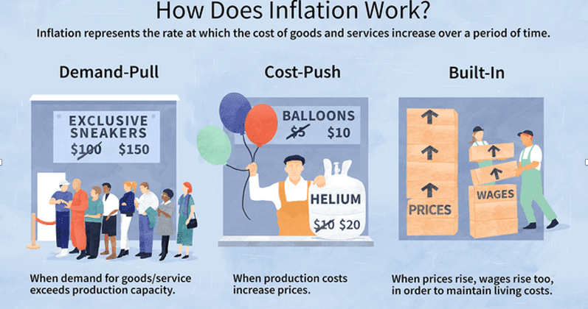
Source: Investopedia

Slide 23
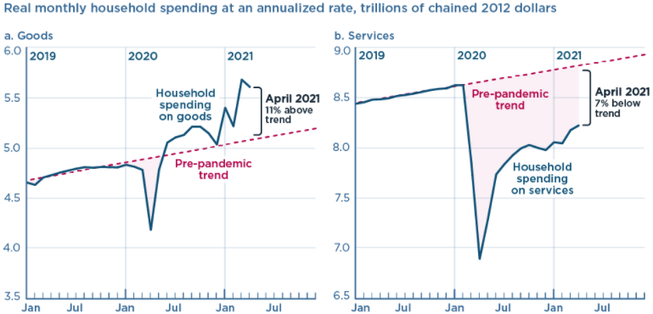
We’re Buying Mostly … Stuff
Demand-Pull
Source: Jason Furman, PIIE

Slide 24
Inflation: Concentrated
Cost-Push

Slide 25
Corporate Profits…Adding to Inflation?

Slide 26
Projected Policy Changes - Fed

Slide 27
FedReaction
Likely to raise interest rates faster than expected – especially if the labor market keeps recovering (fewer demand/supply imbalances, continued recovery of the labor force participation rate and low unemployment rate).

Slide 28
Equity Markets – Is there Overvaluation?
Likely yes – based on negative real earnings yields (inflation adjusted earnings per share) which indicates
that profits are not keeping up with share price increases (even though corporate profits are increasing).

Slide 29
The Great Resignation

Slide 30
Quits Are High! The Great Resignation

Slide 31
Quits – Rising, but More in Some Industries
Accom. & Food Services
Leisure & Hospitality
Retail

Slide 32
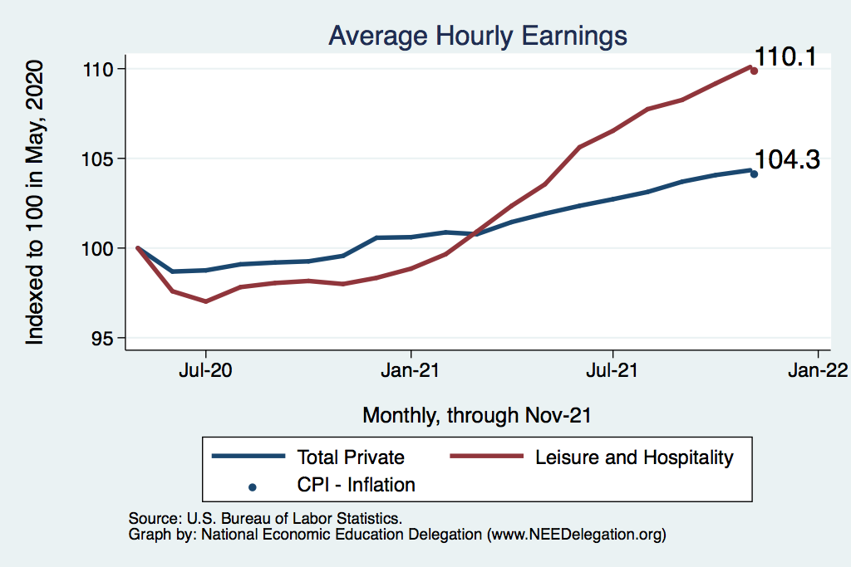
This is Happening as Nominal Wages Rise
Leisure & Hospitality
Total Nonfarm

Slide 33
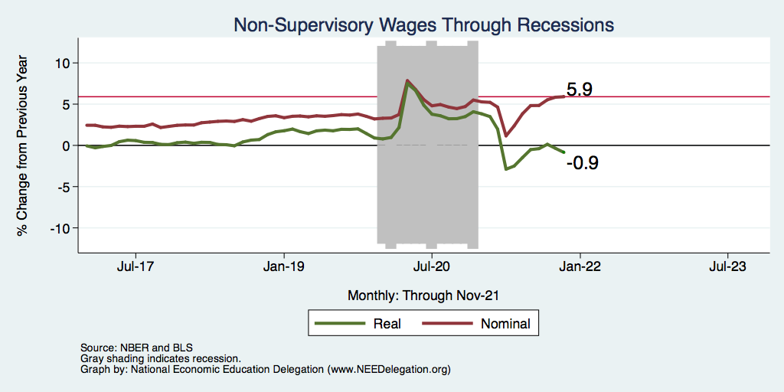
Inflation Adjusted Wages Are Falling

Slide 34
Declining Resources May Change Things
Source: NYTimes.com

Slide 35
Primary Topics Covered
GDP
Recovered the decline, but not where it should be.
Won’t recover previous forecast until late 2022. Growth: 4.0%
Employment
Still down 8.6 million jobs relative to forecast. (3.9 million relative to Feb/20).
Labor force is 2.5 million smaller than at the beginning of the pandemic.
Rising wages are not enticing low-wage workers back to work.
Inflation
Going to be high for a while, but transitory – maybe?
Notes:
IMF: 6% Fed: 5.5%

Slide 36
Conclusion
Recovery is well underway, but will be slowing.
GDP will likely have expanded 5.5% percent in 2021, about 4% in 2022.
Physical health determines economic health for the economy.
Variants may well slow our progress: Omicron.
Gov’t missteps may also hinder progress.
Biggest problems:
Supply chain bottlenecks.
Labor force participation.

Slide 37
Best Measures of Progress
Inflation – getting it under control.
Real wages – need to see progress.
Workforce participation – need growth here to get GDP growth.
Pay less attention to the unemployment rate.

Slide 38
Thank you!
Any Questions?
www.NEEDelegation.org
Jon D. Haveman
Jon@NEEDelegation.org
Contact NEED: info@NEEDelegation.org
Submit a testimonial: www.NEEDelegation.org/testimonials.php
Become a Friend of NEED: www.NEEDelegation.org/friend.php

Slide 39
www.NEEDelegation.org/LocalGraphs
For every state and county in the United States.
Detailed graphs on employment, housing, moves, and other statistics.

Slide 40
Available NEED Topics Include:
Coronavirus Economics
US Economy
Climate Change
Economic Inequality
Economic Mobility
Trade and Globalization
Minimum Wages
Immigration Economics
Housing Policy
Federal Budgets
Federal Debt
Black-White Wealth Gap
Autonomous Vehicles
US Social Policy

Slide 41
Trends in Labor Force Participation
Notes:
CLF16OV.png

Slide 42
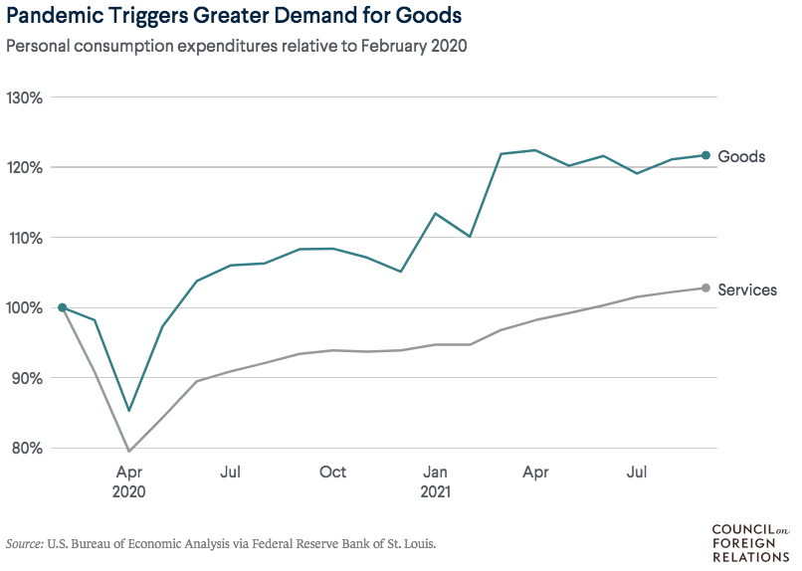
Supply Chains Are at the Core

Slide 43
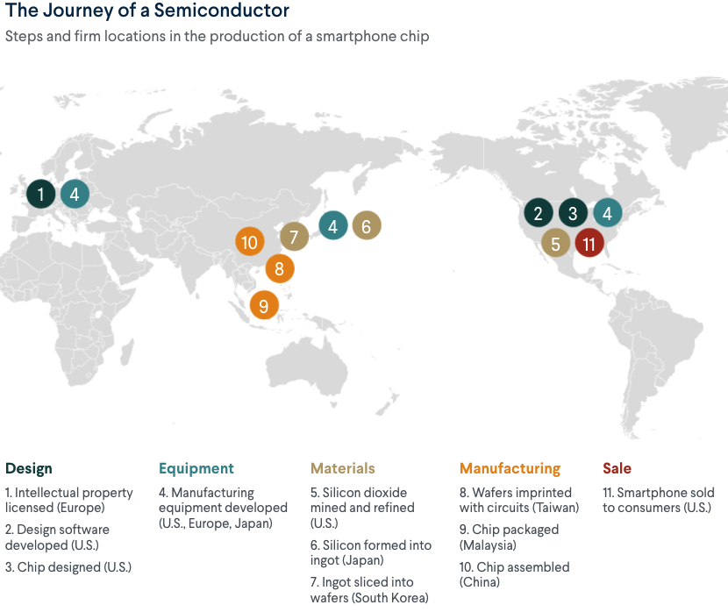
What Are Supply Chains?
https://www.cfr.org/article/what-happened-supply-chains-2021

Slide 44
Puzzle: Is Inflation Permanently Higher?
Fed: Price increases may be:
1) rebound from low prices last year;
2) temporary due to supply chain disruptions; e.g., used cars, bldg supplies.
3) influenced by rising wages in the future.
On the other hand: We are close to full employment and monetary and fiscal policies are very easy.
Nobody knows, but Fed has wavered in its optimism.

Slide 45
Telecommuting – Will it Stick?
Working from home is ALWAYS less productive than working in the office.
But the gap has shrunk because of technology.
In the interest of workplace productivity, employers are likely to allow more working from home.
Increased in-office moral and hence productivity.
But not 100% or even 50%. How much?
Has important implications for real estate.

Slide 46
Residential Real Estate
Rental markets
Eviction moratoria are over.
CA: Making payments can stay + 25%.
Self-evictions?
Not enough in the American Rescue Plan.
Reports of rents rising significantly.
Owned homes
Depends on location.
San Francisco – recovering.
Los Angeles County – continued strength.
Size matters: large homes are selling particularly well.

Slide 47
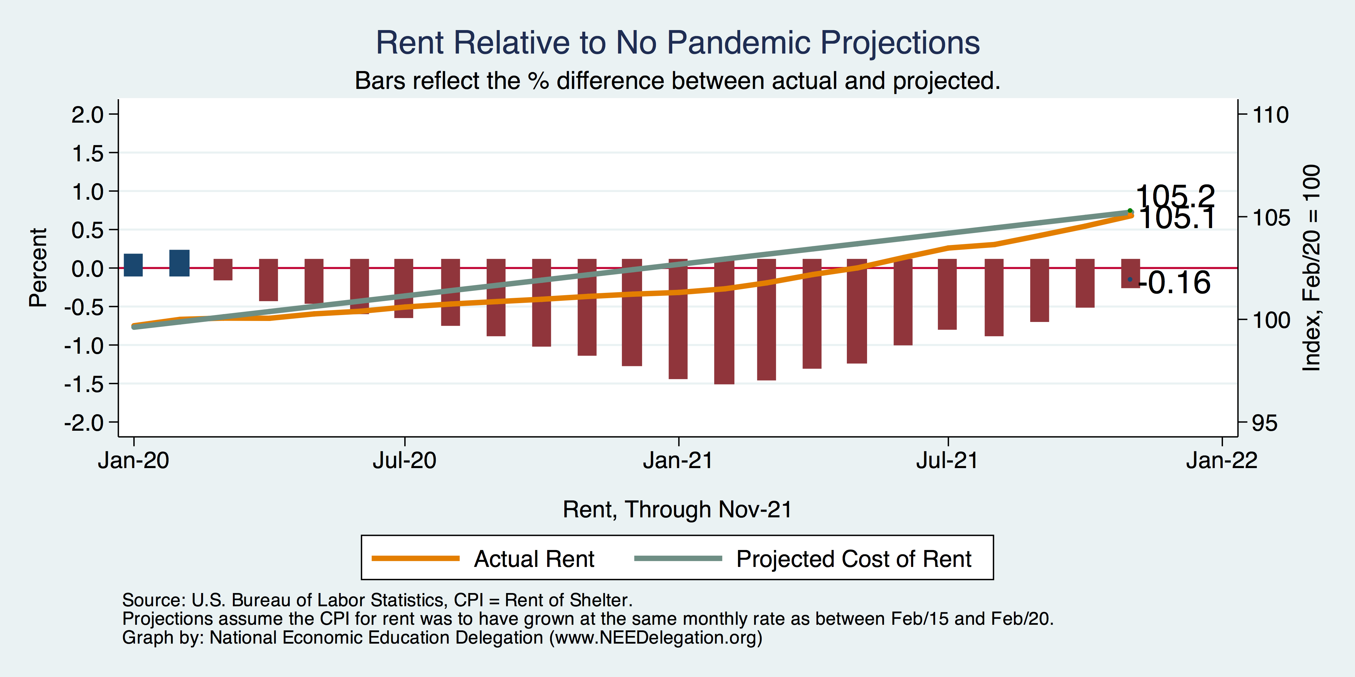
Inflation – Cost of Rent
Notes:
Cpi_recent.png

Slide 48
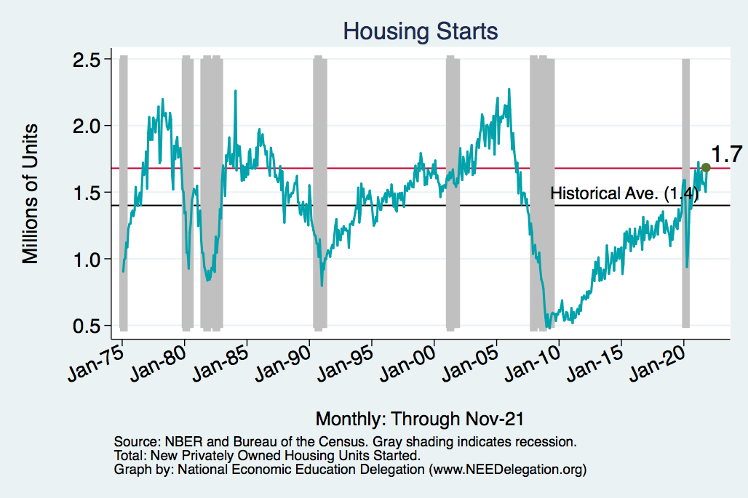
Home Prices and Housing Starts
Notes:
Charts:
homeprices_recession.png
housing.png

Slide 49
Real Estate Prices

Slide 50
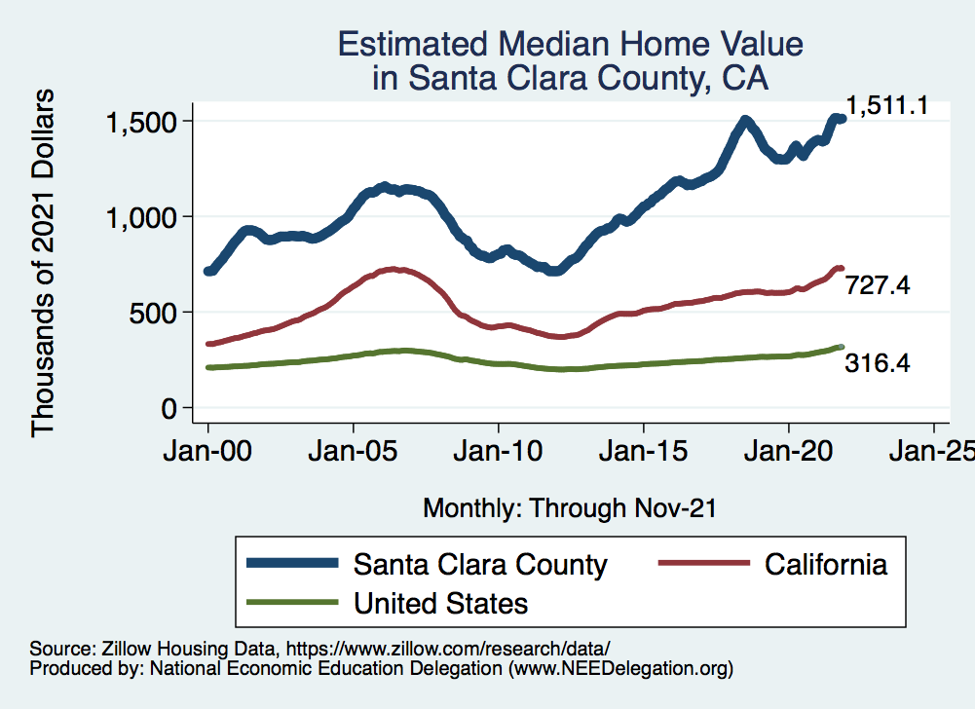
RE Experiences Differ!

